Slide 1
Learning objectives ML1
Main goal of ML1: What is machine learning?
Details:
the following ML algorithms:
linear regression (workshop 1)
logistic regression (workshop 2)
random forests (workshop 4)
data science pipeline (workshop 3)
python + numpy + pandas + linear algebra
industry standard tooling:
Keras, Anaconda, Scikit-learn, Jupyter, Kaggle, Matplotlib, Seaborn, Google collab
at least one individual extension based on personal interest (compulsory)
Mini-project: Kaggle Titanic

Slide 2
Workshop 1: linear regression
AI1

Slide 3
Why learn about linear regression?
Because …
it’s an extremely useful algorithm
it allows showing how machine learning works
there’s a logical evolution from linear regression to neural networks

Slide 4
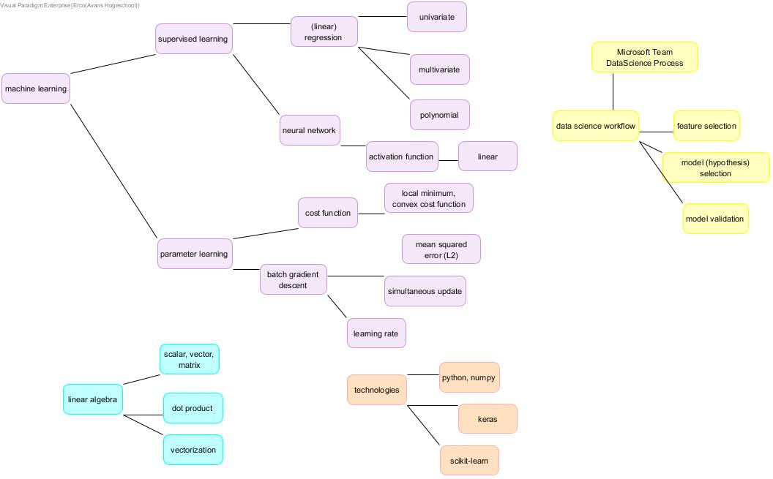
Workshop 1
Introduction of a lot of concepts using a simple algorithm: linear regression

Slide 5
Hands-on assignments
Hands-on 1: Univariate linear regression
Hands-on 2: Multivariate linear regression
Hands-on 3: Univariate linear regression using a Keras-Tensorflow neural network
Hands-on 4: Linear regression in practice

Slide 6
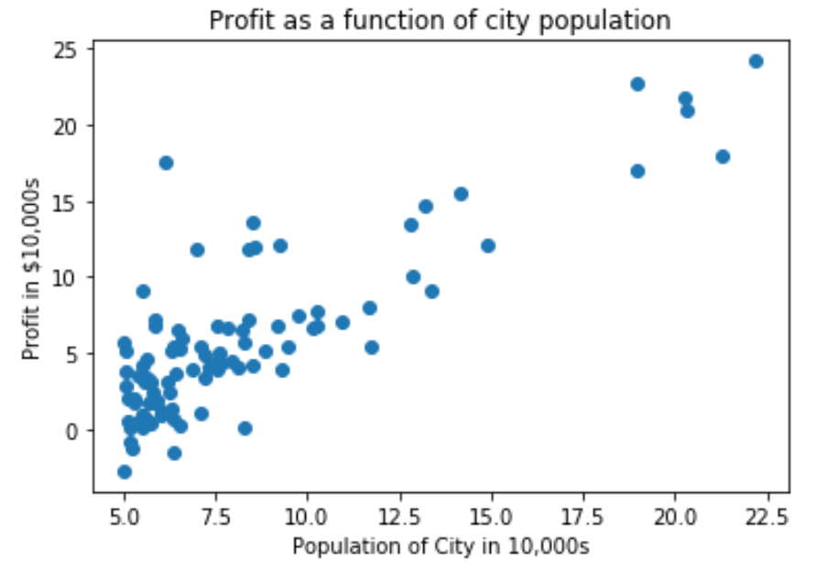
Predict profit?
Continuous variable (as opposed to classification into categories)

Slide 7
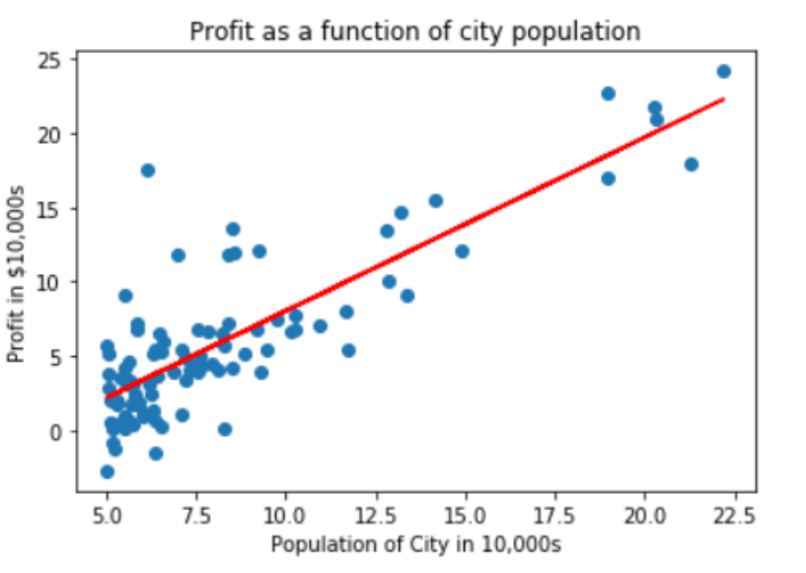
*Choose* a straight line as model

Slide 8
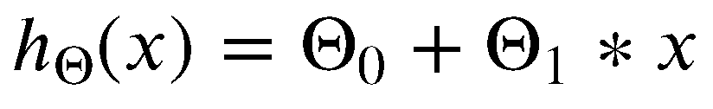
hypothesis (the model)
How to find the best values for theta_0 and theta_1?

Slide 9
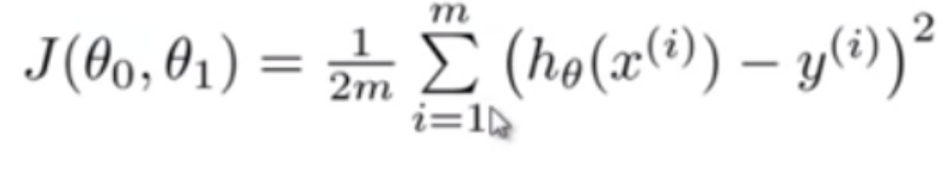
Cost function

Slide 10
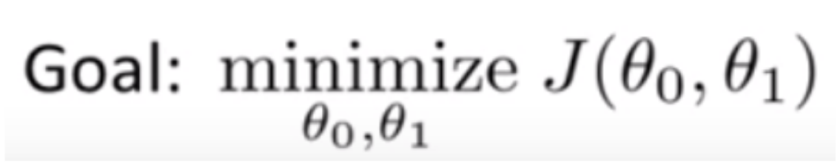
Parameter learning
Parameter learning: fitting the model to the data

Slide 11
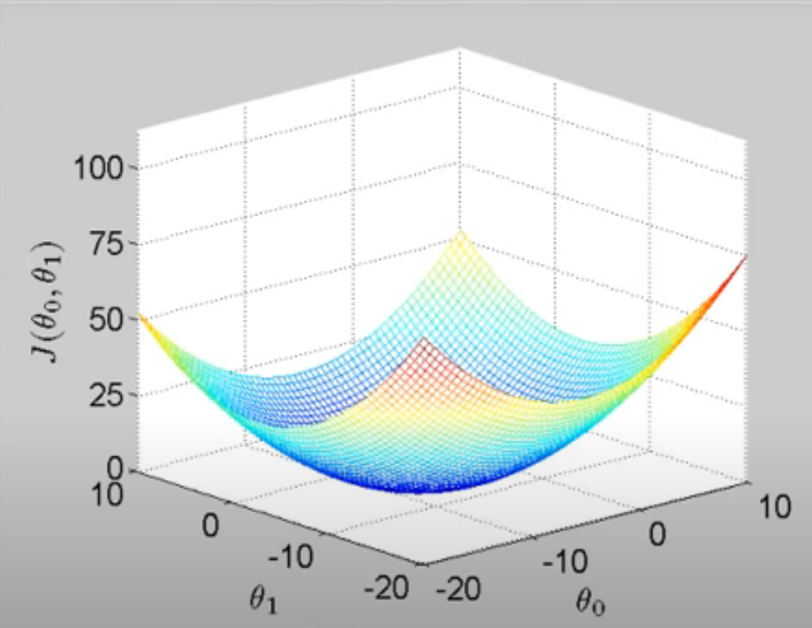
Graph of cost function

Slide 12
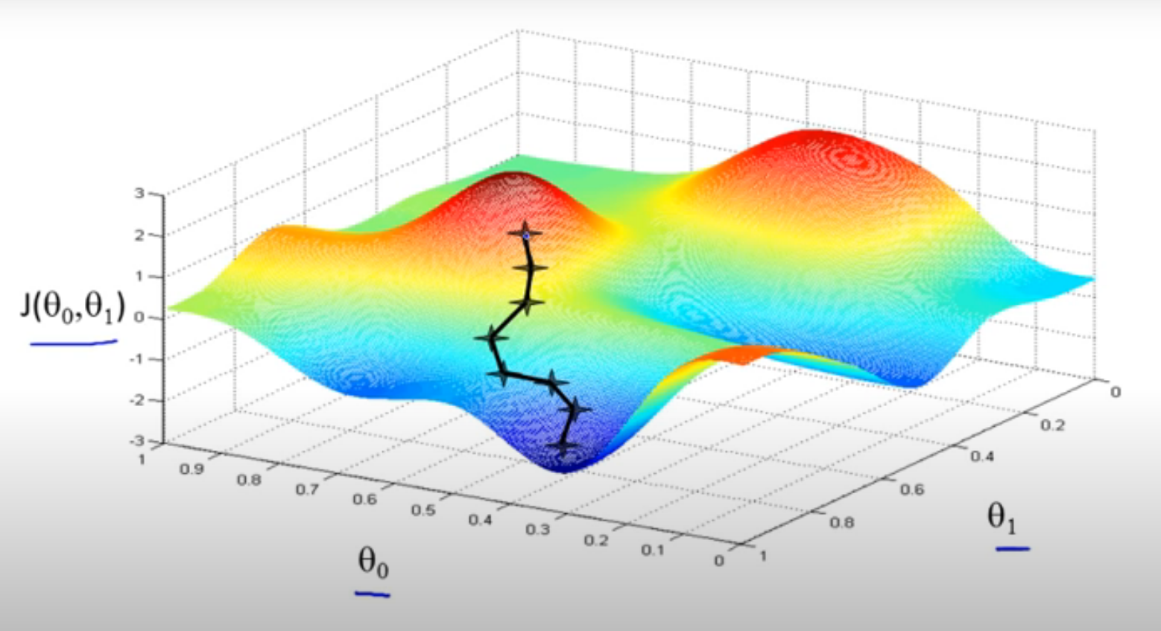
Graph of gradient descent
Beware of local minima

Slide 13
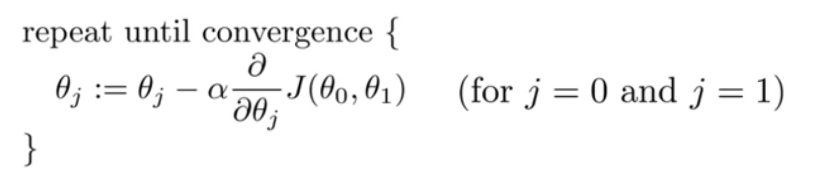
Gradient descent algorithm

Slide 14
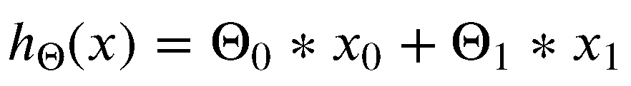
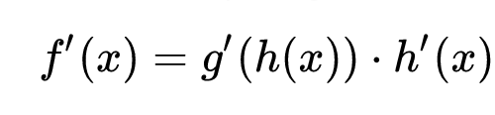
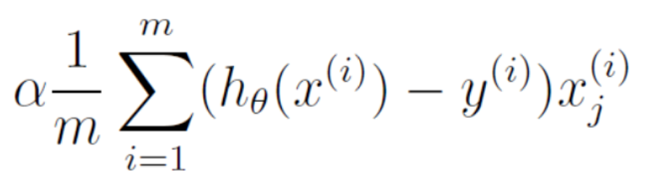
Gradient of cost function
add x₀ to allow uniform handling:
chain rule:

Slide 15
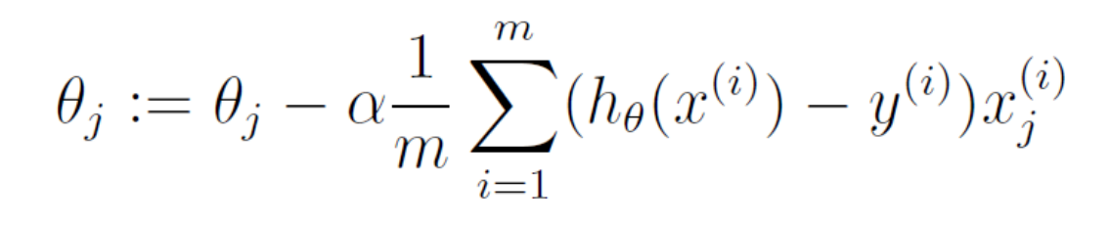
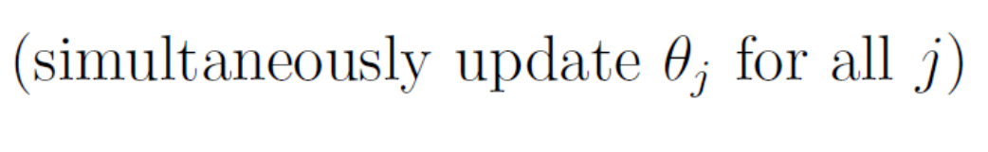
Gradient descent update rule

Slide 16

Now … python
We’re done with the maths!
What’s left is just a matter of translating to python

